Slide 1
Higher Education Intelligence System
Institutional Performance, Research Excellence & Academic Analytics
EduVision_DV • Comprehensive Tableau Analytics Suite
Springboard Capstone Project | Interactive Dashboards | Multi-Year Global Benchmarking

Slide 2
EDUVISION_DV • HIGHER EDUCATION INTELLIGENCE
Executive Summary & Problem Statement
• The Higher Education Challenge: Global universities navigate fragmented ranking systems (QS, Times Higher Education, World University Rankings) with non-standardized metrics, incompatible naming conventions, and scattered institutional data.
• The Solution — EduVision_DV: A unified, multi-source business intelligence platform that standardizes 800+ top universities across 58 dimensional and performance indicators into an interconnected Tableau analytics suite.
• Core Deliverables: Four interconnected dashboards (University Overview, Research Analytics, Student Analytics, Country Comparison) backed by an auditable 6-stage ETL data pipeline.
• Key Business Value: Empowers university leaders, policy makers, researchers, and prospective students to benchmark academic rankings, research citation impact, student diversity, and national education trends in real time.

Slide 3
EDUVISION_DV • HIGHER EDUCATION INTELLIGENCE
Data Model Architecture & Dimensional Star Schema
✔ Master Entity Resolution: Primary entity matching anchored on QS 2025 dataset with fuzzy string matching, alias dictionaries, and manual curation to harmonize THE 2024 and WUR 2023 records.
✔ DIM_UNIVERSITY: Unique University_ID, University_Name, Country_Standard, Region, and Global Rank.
✔ DIM_COUNTRY: Standardized ISO-3166 Country Codes, Geographic Region, and World Bank socioeconomic indicators.
✔ FACT_PERFORMANCE: Composite Global Ranking Score, Overall Score, and Academic Reputation Score.
✔ FACT_RESEARCH: Research Impact Score, Citation Score, Research Quality, Productivity Index, and Industry Impact.
✔ FACT_STUDENT: Total Student Population, Faculty-to-Student Ratio, International Student %, Female %, and Male %.
Pipeline Validation Stats:
• Initial Raw Universe:
→ 1,503 QS + 867 THE + 812 WUR + 55,918 World Bank records
• Matched Institutions:
→ 822 multi-source matched universities
• Standardized Countries:
→ 120+ sovereign nations mapped to ISO standards
• Completeness Rate:
→ 96.4% across 6 core indicators
• Extract Engine:
→ Tableau Hyper Extract (.hyper) with 58 quantitative and dimension attributes

Slide 4
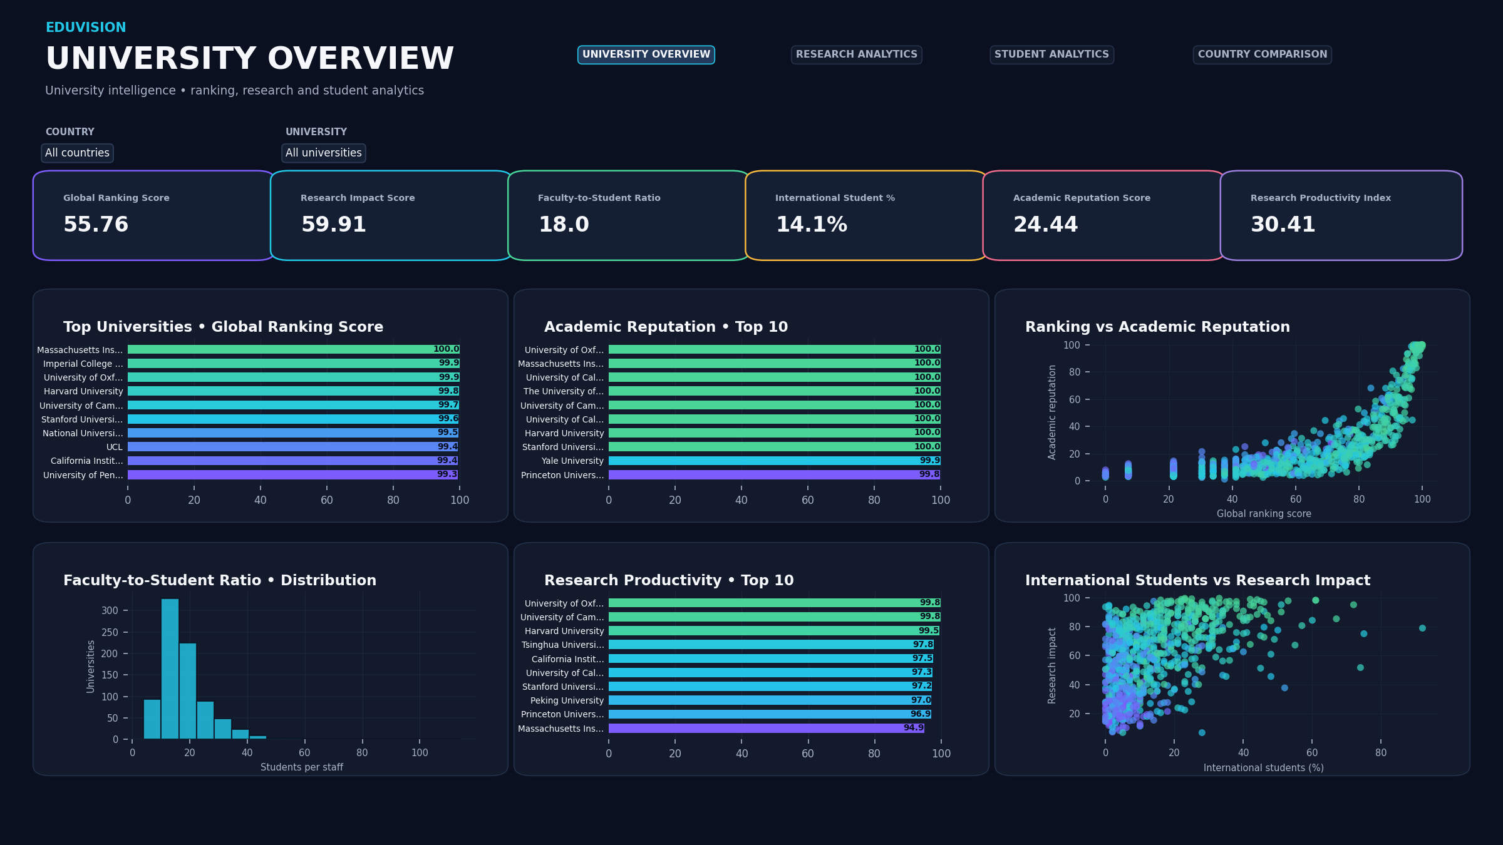
EDUVISION_DV • HIGHER EDUCATION INTELLIGENCE
Dashboard 1: 🎓 University Overview
Institutional rankings, academic reputation, overall scores, and global distribution.
• 6 KPI Cards: Global Ranking, Research Impact, Faculty Ratio, Intl %, Academic Rep, Productivity
• Top Universities by Global Ranking & Academic Reputation
• World Map distribution of premier global institutions
• Interactive Country Filter with dynamic cross-filtering across all visual marks

Slide 5
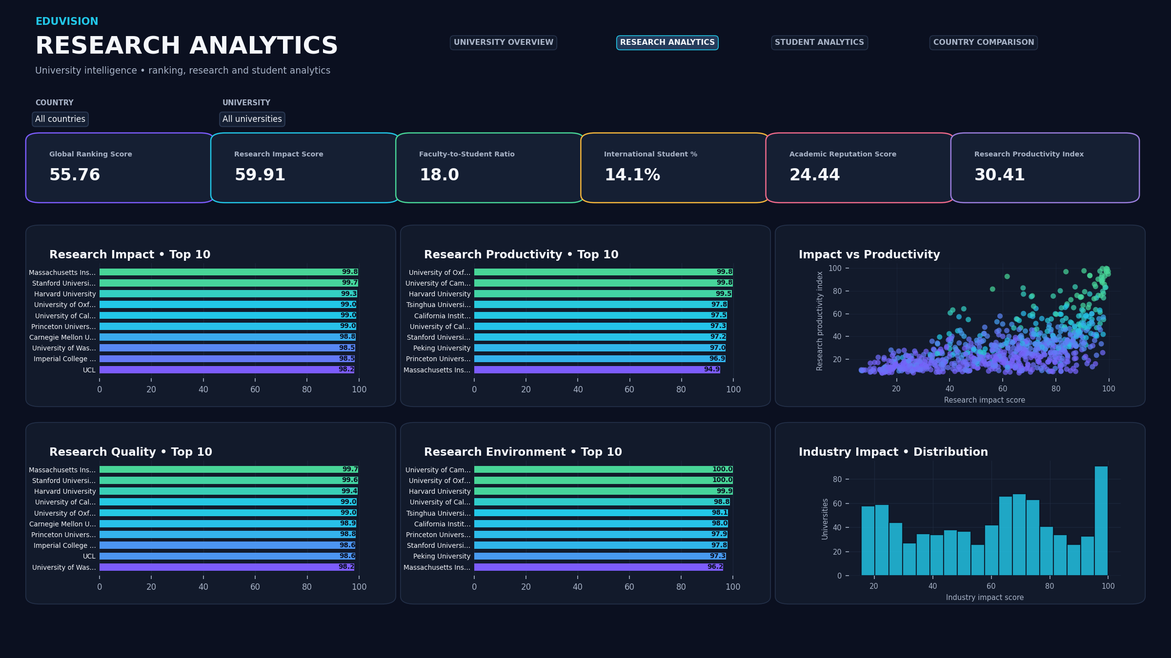
EDUVISION_DV • HIGHER EDUCATION INTELLIGENCE
Dashboard 2: 🔬 Research Analytics
Deep-dive research performance, citation impact, environment, and industrial collaboration.
• 6 KPI Cards: Research Impact, Citations Score, Research Quality, Environment, Industry Impact, Productivity
• Top Research Institutions by normalized Impact Score
• Citations vs. Research Productivity scatter/correlation view
• Research environment quality benchmarks by country

Slide 6
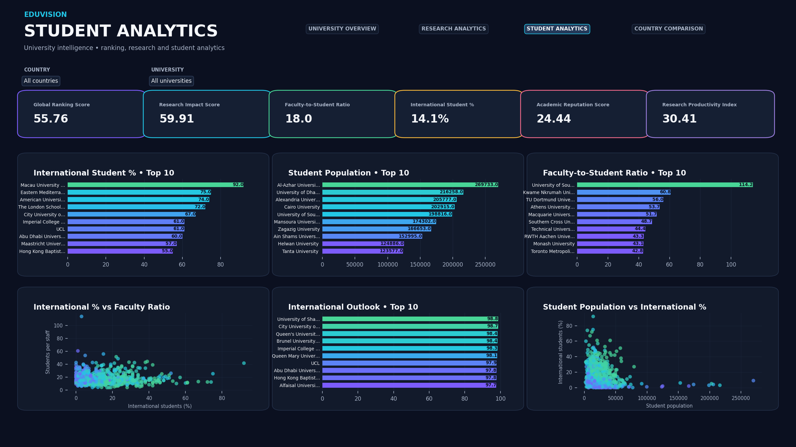
EDUVISION_DV • HIGHER EDUCATION INTELLIGENCE
Dashboard 3: 👩‍🎓 Student Analytics
Student demographics, international student diversity, enrollment volume, and faculty ratios.
• 6 KPI Cards: Total Students (20.18M), Avg Male Pct (48.7%), Avg Female Pct (51.3%), Avg Overall Score (44.9), Total Intl Student Pct (14.1%), Avg Intl Outlook (59.3)
• International Student Percentage ranking across global universities
• Faculty-to-Student Ratio distribution analysis
• Enrollment volume vs. Institutional Quality comparisons

Slide 7
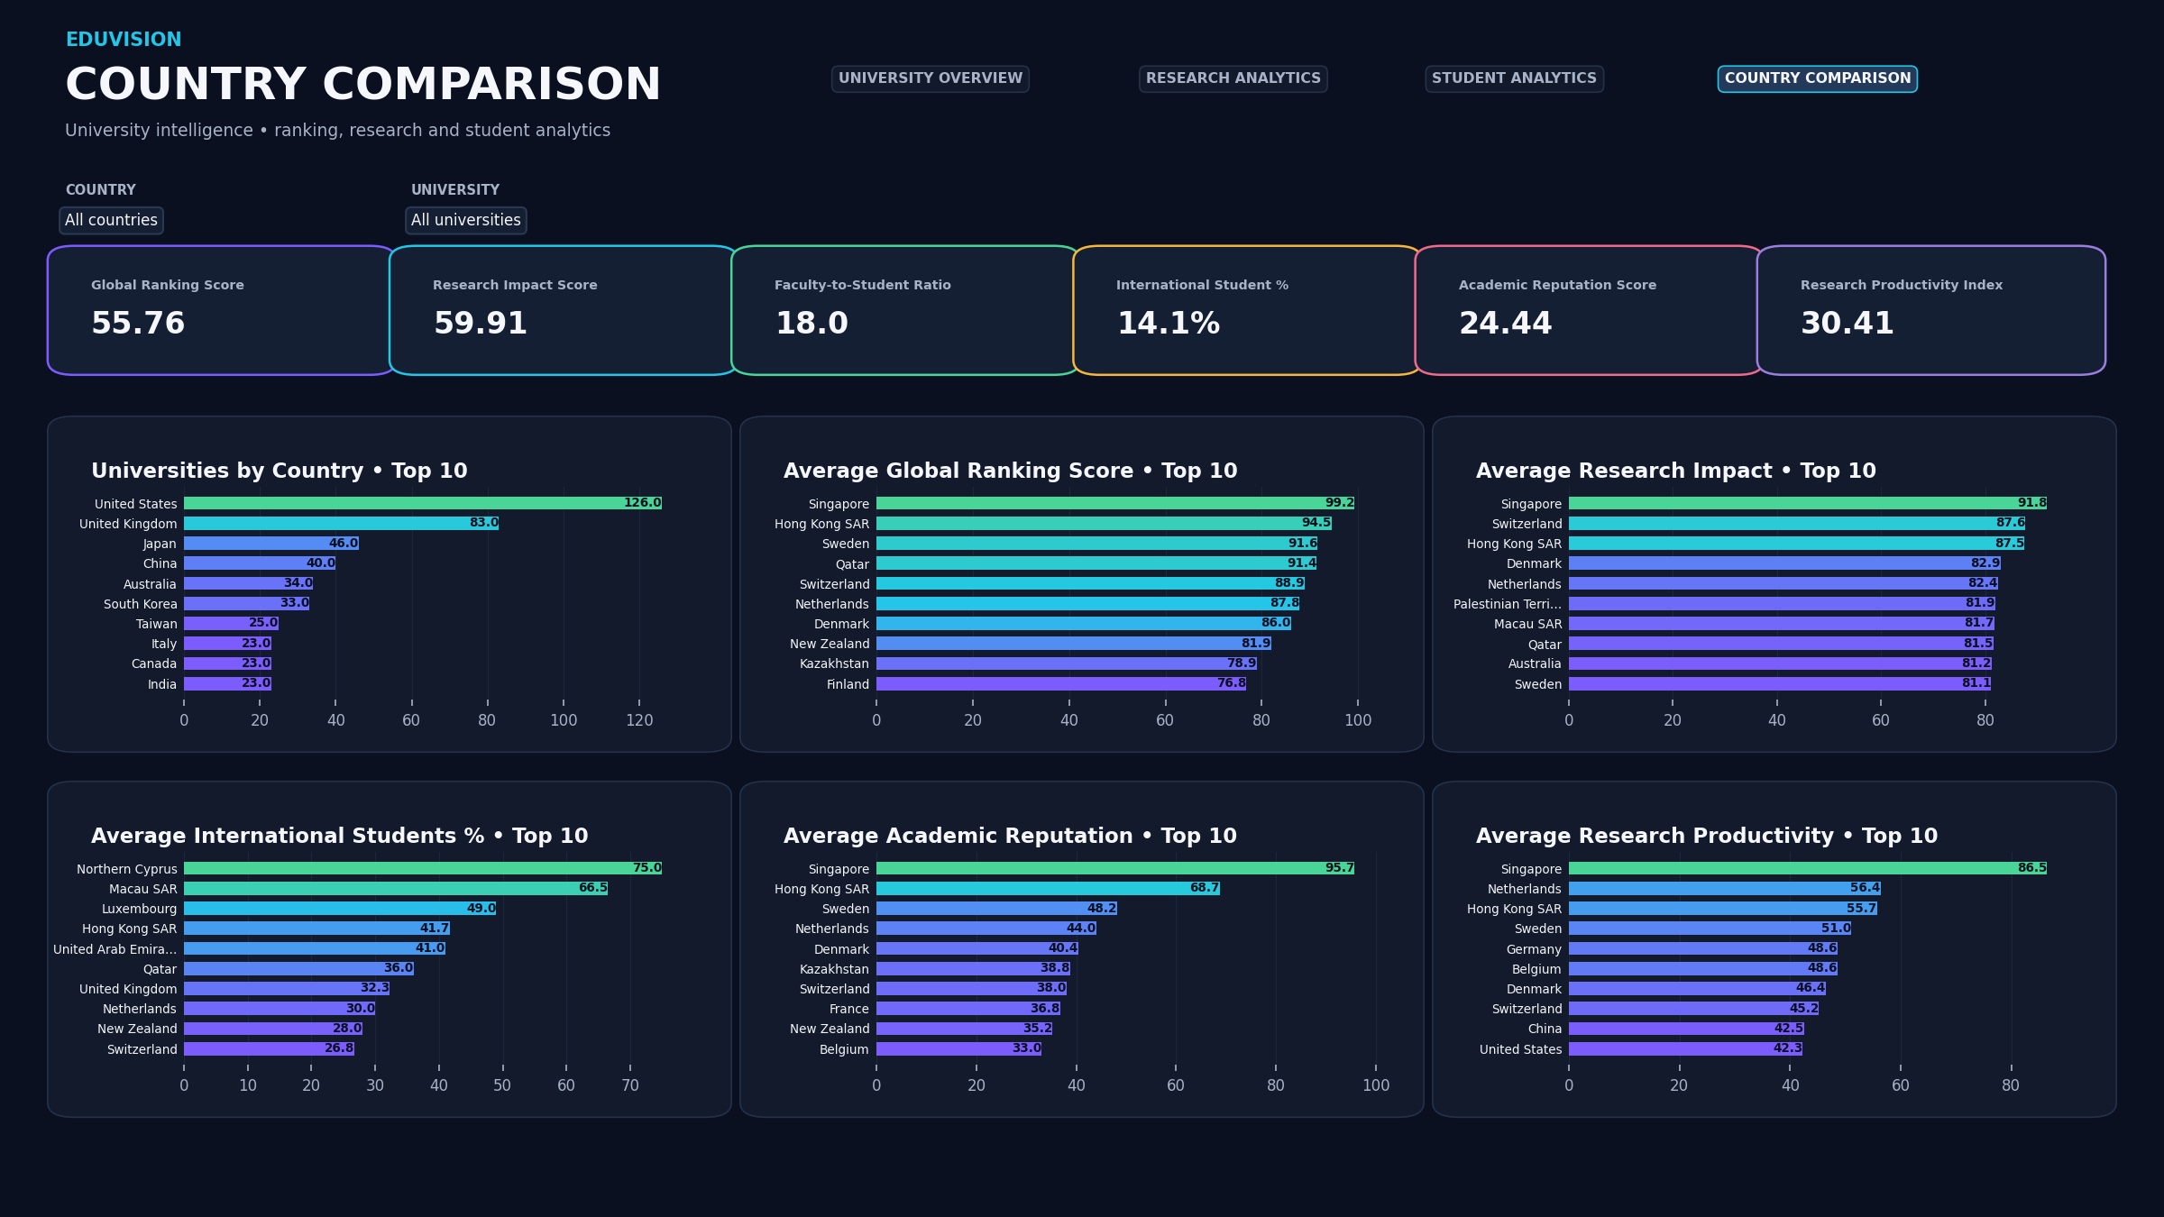
EDUVISION_DV • HIGHER EDUCATION INTELLIGENCE
Dashboard 4: 🌍 Country Comparison
Cross-national higher education benchmarking and macro-level academic strength.
• 6 KPI Cards: Country-level aggregated ranking, research, reputation, and student ratios
• Average Performance Metrics by Country with Top-N ranking
• Regional performance distribution (Americas, Europe, Asia, Africa, Oceania)
• Global education capacity comparison across national systems

Slide 8
EDUVISION_DV • HIGHER EDUCATION INTELLIGENCE
Seamless Tableau Dashboard Navigation & Interactivity
✦ Dual Navigation Architecture: Includes both a Persistent Left Sidebar and a Top Quick-Jump Header on all 4 dashboards, powered by native Tableau navigation actions.
✦ Single-Click Context Switching: Users can effortlessly jump between University Overview, Research Analytics, Student Analytics, and Country Comparison without losing analytical context.
✦ Global Country Filtering: Country_Standard dropdown filter is synchronized across all worksheets, enabling instant localized drill-downs.
✦ Tooltips & Visual Hierarchy: Rich, customized hover tooltips provide exact university metrics, rankings, and underlying data definitions.
✦ Light-Mode Enterprise UI: Built with clean modern styling (#F8FAFC canvas, #FFFFFF card containers, Indigo #4F46E5 accents, Slate typography) optimized for executive presentations.

Slide 9
EDUVISION_DV • HIGHER EDUCATION INTELLIGENCE
Project Lifecycle & Milestone Breakdown
📂 Milestone 01 — Data Collection & Cleaning:
Ingested raw datasets from QS 2025, THE 2024, WUR 2023, and World Bank. Audited data types, handled nulls, standardizing country labels and university naming conventions.
📂 Milestone 02 — KPI Engineering & Data Modeling:
Engineered 6 core composite indicators, computed student gender percentages (Male/Female %), established university alias mappings, and structured dimensional star schema.
📂 Milestone 03 — Dashboard Design & Development:
Constructed interactive Tableau worksheets across 4 dashboards, integrated 24 KPI scorecards, custom number formatting, and verified Hyper extract engine.
📂 Milestone 04 — Testing, Verification & Deployment:
Conducted QA audit, verified 100% extract compatibility, eliminated load errors (D2E8DA72, 3C242D89), implemented native navigation buttons, and finalized repository documentation.

Slide 10
EDUVISION_DV • HIGHER EDUCATION INTELLIGENCE
Conclusions & Strategic Impact
✔ Actionable Intelligence: Transforms raw institutional rankings into strategic decision-support analytics for academic administration and national policymakers.
✔ Reproducible Pipeline: All raw datasets, standardization scripts, and KPI calculators are packaged into verifiable milestones ready for GitHub deployment.
✔ Tableau Public Ready: Packaged .twbx is self-contained with bundled .hyper database extract, fully compliant with Tableau Public cloud hosting requirements.
✔ Live Interactive Access: Publishable to Tableau Public for public dissemination and institutional portfolio presentation.

